Slide 1


Process Scheduling
Decide which process should run and for how long
CPU-I/O burst cycles
Process execution and I/O wait
Dispatch latency
Time required to switch contexts
Policy: Maximize CPU utilization Mechanism:Multiprogramming

Slide 2
Dispatcher
Give control of the CPU to the process selected by the short-term scheduler
This involves:
  switching context
  switching to user mode
  Setting the program counter to restart the process
Dispatch latency – Time required to stop one process and start another running

Slide 3

Histogram of CPU-burst Times
Average burst times per process

Slide 4
Scheduling Decisions
Gives CPU control to a process in the ready queue
CPU scheduling decisions occurs when a process changes state
  1.Switch: running to waiting state 2.Switch: running to ready state
  3.Switch: waiting to ready 4.Switch: running to terminated
Some decisions are non-preemptive, others are preemptive
Scheduling policies
  Maximize Throughput (processes completed per time unit)
  Minimize Turnaround time (total time to execute a particular process)
  Minimize Wait time (total time waiting in the ready queue)
  Minimize Response time (delay in time from request until first response)
  Maximize CPU utilization (CPU idle time percentage)
How do we evaluate scheduling algorithms
  Deterministic modeling – particular predetermined workload
  Simulation using various queuing models
  Actual implementation

Slide 5
First-Come, First-Served (FCFS) Scheduling
Process Burst Time
P1 24
P2 3
P3 3
First arrival order: P1 , P2 , P3
The Gantt Chart schedule is:
Waiting time: P1=0; P2=24; P3=27
Average waiting time:
(0 + 24 + 27)/3 = 17
Second arrival order: P₂ , P₃ , P₁
The Gantt chart schedule is:
Waiting time: P₁ = 6; P₂ = 0; P₃ = 3
Average waiting time:
(6 + 0 + 3)/3 = 3
Much better than previous case
Avoids short processes waiting behind the long process
P₂
P₃
P₁
0
3
6
30
P₁
P₂
P₃
0
24
27
30

Slide 6
Shortest Job First Scheduling
Algorithm
  Estimate the length of the next process CPU burst
  Schedule the process with the shortest next burst
Two schemes:
  Shortest Job First (SJF): Process guaranteed to finish its next burst (non-preemptive)
  Shortest-Remaining-Time-First (SRTF): Schedule new arrivals when their burst is less than what remains for the running process (preemptive)
Evaluation
  Advantage: Minimizes wait time if the burst estimate is accurate
  Disadvantage: CPU bursts cannot be known in advance

Slide 7
Preemptive and non-preemptive Examples
Schedule using the length of the next cpu burst
Process Arrival Burst
P₁ 0.0 7
P₂ 2.0 4
P₃ 4.0 1
P₄ 5.0 4
SJF (non-preemptive)
Average wait: (0+6+3+7)/4 = 4
Process Arrival Burst
P₁ 0.0 7
P₂ 2.0 4
P₃ 4.0 1
P₄ 5.0 4
SRTF (preemptive)
Average wait: (9 + 1 + 0 +2)/4 = 3
P₁
P₃
P₂
P₄
P₁
P₂
P₃
P₂
P₄
P₁
0
3
7
8
12
16
0
2
4
5
7
11
16
Question: How to estimate CPU bursts? Answer: exponential averaging
t_{n} = n^{th} burst length, τ_{n}=estimated n^{th} burst length, α=constant where 0≤α≤1
τ_{n+1} ≈ α t_{n} + (1- α )τ_{n}

Slide 8

Exponential Averaging Examples
Project the time for the next CPU burst
Fixed quantums, history doesn’t count
α =0 , τ_{n+1} = τ_{n}
Only the Last burst counts
α =1 , τ_{n+1} = t_{n}
Vary the impact of past bursts
α and (1 - α) ≤ 1
Example on right:
Initialize τ₀ to 10, α = ½
Example: τ₁ = α t₁ ₊ (1- α)τ₀ = ½ 6 + ½ 8, where τ₀ is initialized to 10

Slide 9
Priority Scheduling
Assign a priority integer value to each process
Highest priority wins (Some systems: smallest integer ≡ highest priority)
Priority algorithms can be either preemptive or non-preemptive
  SJF is a priority scheduler: priority = predicted next CPU burst
  FIFO is a non-preemptive priority scheduler: priority = time waiting
Preemptive schemes (Round Robin – RR)
  Schedule when quantum expires (10-100 millisecond)
  Large quantum ≈ FIFO; Small quantum (q) incurs high overhead
  Maximum wait is (n-1)*q for processes of the same priority
  Each process uses 1/n of CPU (minus scheduling overhead)
Problem and solution
  Problem: Low priority processes may never execute (starvation)
  Solution: Increase a process priority as wait time increases (aging)

Slide 10
Example of RR with Time Quantum = 20
Process Burst Time
P₁ 53
P₂ 17
P₃ 68
P₄ 24
Compared to SRJ: Worse average turnaround; better response
P₁
P₂
P₃
P₄
P₁
P₃
P₄
P₁
P₃
P₃
0
20
37
57
77
97
117
121
134
154
162

Slide 11


Round Robin Scheduling (RR)
Round Robin Gantt Chart
Turnaround Vs. Quantum Size
Processes exceeding their time quantum go to the back of the queue

Slide 12

Multilevel Queues
Multiple
Ready
Queues
Design questions and possible answers
How many queues? A number of interactive foreground priority-based queues; a single background batch queue
Which scheduling algorithms? Interactive – RR, Background – FCFS
When to upgrade or demote a process? Demote processes whose quantum expires, Promote if I/O to compute ratio falls below threshold
Scheduling between queues? Allocate CPU % to each interactive queue. Favor foreground over background
Multilevel-feedback: Allows processes to migrate between multilevel queues

Slide 13

Multilevel Feedback Example
Three queues
  Q₀ Processes have 8 millisecond quantum, FCFS algorithm
  Q₁ Processes have 16 millisecond quantum, FCFS algorithm
  Q₂ – FCFS
Scheduling
  New jobs enters queue Q_{0.} They move to Q₁ if quantum expires
  Jobs in Q₁ receive a new quantum. They move to Q₂ if their Q1 quantum expires

Slide 14
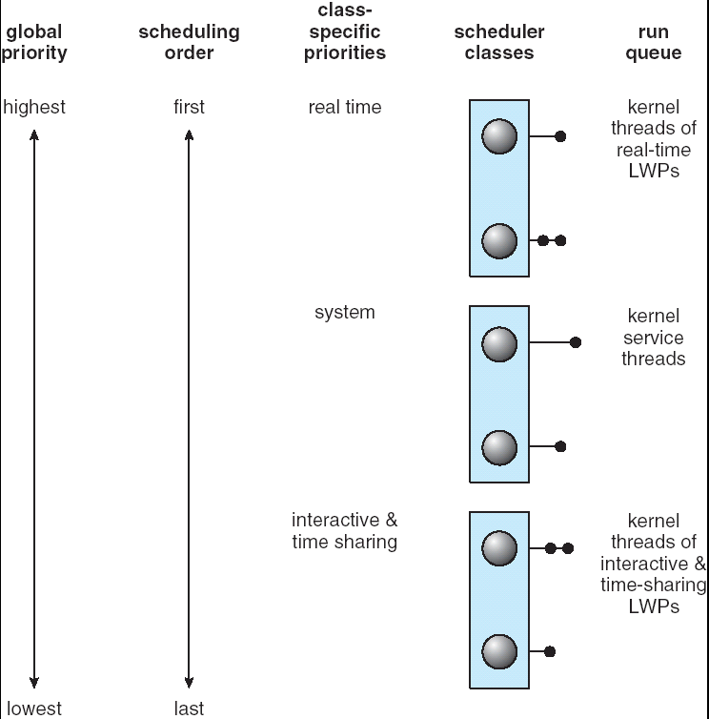

Solaris Scheduling
Interactive and Time Share
Categories

Slide 15
Solaris Dispatch Table
Priority: a higher number indicates a higher priority. Processes that wait too long get a priority boost.
Time Quantum: the time quantum for the associated priority
Time Quantum expired: the priority of a thread that has used its entire time quantum without blocking. It’s priority is demoted.
Return from sleep: the priority of a thread that is returning from sleeping (such as waiting for I/O). It gets a priority boost.

Slide 16

Windows XP Scheduling
Multilevel feedback queue
Algorithm: Priority-based, preemptive; time critical processes preempt lower priority classes (soft real time scheduling).
Columns: process priority classes. For example: real time, high, above normal, normal, below normal, and idle.
Rows: relative priority values a particular process can assume. For example, real time processes can have priorities from 16 to 31.

Slide 17

Linux Scheduling
Time-sharing algorithm
  Higher priority numbers
  Schedule process with most credits
  Timer interrupt: reduce credit
  Context switch if credits = 0
  Re-credit (based on priority and history ) if no processes have credits left
Soft Real-time algorithm
  Lower priority numbers
  Two Posix.1b compliant classes where highest priority classes always run first
    First Class: FCFS
    Second Class: Round Robin
Quantum length vs. Priority

Slide 18

Linux List of Tasks Indexed According to Priorities
Constant order O(1) scheduling algorithm with two arrays of run queues
  Active array: ready, not-yet-run tasks
  Expired array: already-ran-and-expired tasks
Run highest priority active array tasks, move to expired when quanta expires
If a priority active array empties, swap active/expired arrays. Then re-credit quanta and possibly adjust priority by +/- 5. More process wait time means higher priority

Slide 19
Multiprocessor Scheduling
Algorithms are more complex
Homogeneous processors: same architecture on all processes
  Any process can run on any available processor
Categories of multiprocessing
  Asymmetric: One processor controls resources & scheduling
  Symmetric: All share resources and scheduling decisions. Each processor has its own ready queues and data structures.
Load Balancing Algorithms
  Push: Processors push jobs to other processors
  Pull: lightly loaded processors pull from other processors
  Threshold variable determines when to migrate
Difficulties in migrating processes
  Lots of data to move
  Lose cache advantage (must be invalidated and repopulated)
  Soft affinity: migration possible; Hard affinity: never migrate

Slide 20
Thread Scheduling
Local scheduling (PTHREAD_SCOPE_PROCESS)
  The thread library (ex: Pthreads) assigns threads to an available light weight process
  Contention is between active application threads
Global Scheduling (PTHREAD_SCOPE_SYSTEM)
  Kernel schedules threads on available processors
  Contention is between kernel threads
JVM Scheduling – non-preemptible (cooperative) unless
  A thread blocks or yields execution
  A higher priority thread becomes runnable
  Note: Java programs yield() to ensure fair share processing
    while (true) {// perform some task; Thread.yield();}
    Yield() gives control to Another thread of equal priority
  Note: some systems support preemption

Slide 21
Pthreads Example
int main(int argc, char *argv[])
{ int i, scope, THREADS = 10;
pthread_t tid[THREADS];
pthread_attr_t attr;
pthread_attr_int(&attr); // get the default attributes
// Set for kernel level scheduling
pthread_attr_setscope(&attr, PTHREAD_SCOPE_SYSTEM);
for (i=0; i<THREADS; i++) pthread_create(&tid[i], &attr, run, NULL);
for (i=0; i<THREADS; i++) pthread_join(tid[i], NULL);
}
void *run(void *param)
{ /* do something */
pthread_exit(0);
}
The NULL in create is for passing arguments
The Null in join is for a return value

Slide 22
Java Threads
Create thread: implements Runnable or extends thread
Spawn thread: call the start() method
Scheduling: dependent on underlying OS.
Threads run till:
  Quantum expires
  Blocks for I/O
  Leave run() method
  Sleep() or yield()
Priority range (Between 1 and 10)
  Thread.MIN_PRIORITY (1)
  Thread.NORM_PRIORITY (5)
  Thread.MAX_PRIORITY (10)
Set priority: thread.setPriority(Thread.NORM_PRIORITY);

Slide 23
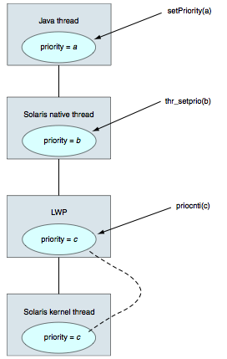
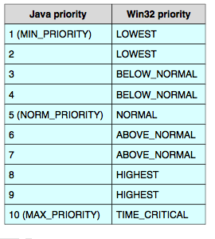
Java to OS Scheduling
Java and Windows
Java and Solaris

Slide 24

Evaluating Scheduling Algorithms
Paper and Pencil Gantt chart analysis
Run predetermined work loads
Run simulations using queuing theory
Actual live implementations. Humans are good at defeating the best algorithms

